Slide 1
Uninformed Search
WIA 1004
FUNDAMENTALS OF AI

Slide 2
Uninformed Search Strategies
Consist of the following:
Breadth first search
Depth first search
Iterative deepening search
Bidirectional search
For each of this strategies, we will learn:
The algorithm
Time and space complexities
When to select a particular strategy

Slide 3
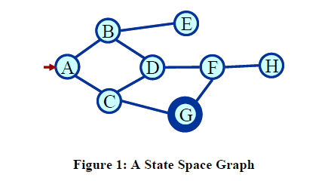
Find a path
Shortest path
Any path
Blind search
BFS
DFS

Slide 4
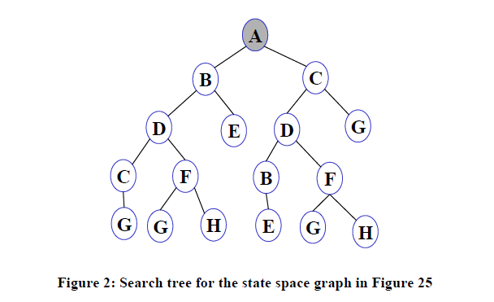
Search Tree
List all possible paths
Eliminate cycle from paths
Result: A search tree

Slide 5
Search Tree - Terminology
Root node
Leaf node
Ancestor/descendant
Branching factor
Complete path/Partial path
Expanding open nodes results in close nodes

Slide 6
Basic Search Algorithm
Let fringe be a list containing the initial state
Loop
if fringe is empty return failure
Node remove-first (fringe)
if Node is a goal
then return the path from initial state to Node
else generate all successors of Node
merge the newly generated nodes into fringe
End loop

Slide 7
Evaluating Search Strategies
Measuring problem solving performance:
Completeness – is the strategy guaranteed to find a solution if one exists?
Optimality – does the solution require low cost or the minimal cost?
Time complexity – time taken (number of nodes expanded) (worst or average case) to find a solution.
Space complexity – space used by the algorithm measured in terms of the maximum size of fringe

Slide 8
Search Strategies
Blind search
Depth first search
Breadth first search
Iterative deepening search
Iterative broadening search
Informed search
Constraint satisfaction search
Adversary search

Slide 9
Breadth First Search
Let fringe be a list containing the initial state
Loop
if fringe is empty return failure
Node remove-first (fringe)
if Node is a goal
then return the path from initial state to Node
else generate all successors of Node %% Expand shallowest node first
add generated nodes to the back of fringe
End loop

Slide 10
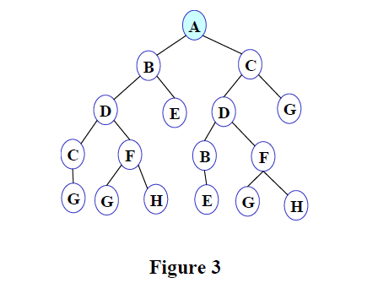
BFS Illustration
FRINGE: A

Slide 11
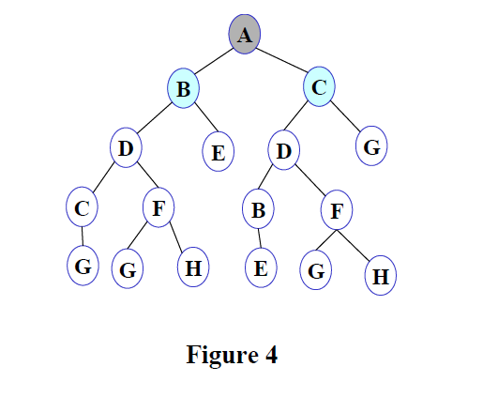
FRINGE: B C

Slide 12
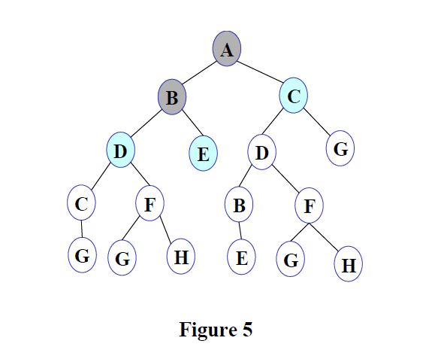
FRINGE: C D E

Slide 13
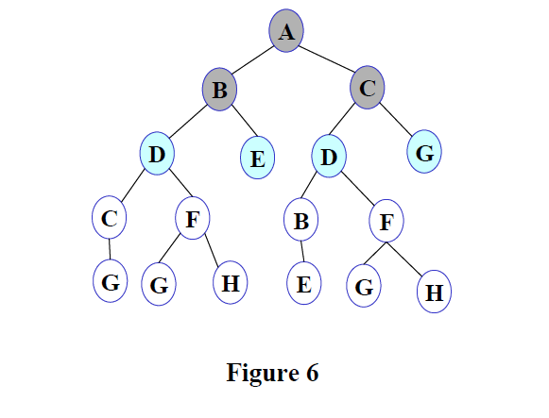
FRINGE: D E D G

Slide 14
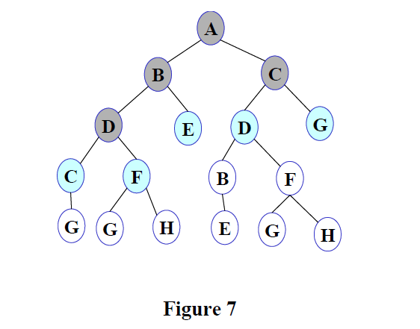
FRINGE: E D G C F

Slide 15
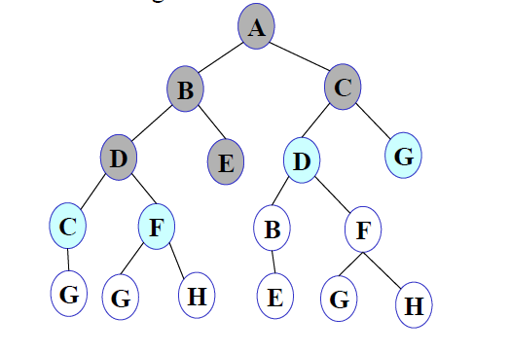
FRINGE: D G C F

Slide 16
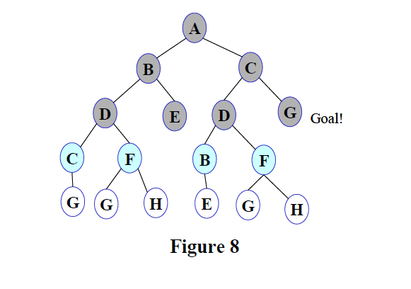
FRINGE: G C F B F

Slide 17
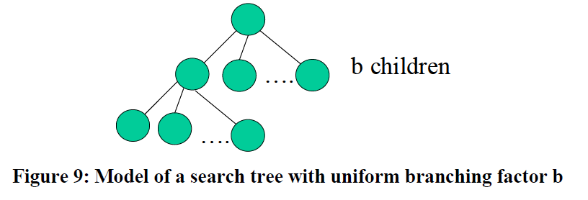
Model of Search Tree
d: depth of the shallowest goal node
m: maximum depth of the search tree

Slide 18
Breadth First
Breadth first search is:
FIFO order.
Complete.
The algorithm is optimal (i.e. admissible) if all operators have the same cost. Otherwise, finds a solution with the shortest path length.
Exponential time and space complexity, O(b^{d}), where d is the depth of the solution and b is the branching factor (i.e. number of children) at each node

Slide 19
Breadth First
A complete search tree of depth d where each non-leaf node has b children, has a total of
1+b+b²+…+b^{d} = (b^{(d+1)}-1)/(b-1) nodes
For a complete search tree of depth 12, where every node at depths 0, 1, …, 11 has 10 children and every node at depth 12 has 0 children, there are O(10¹²) nodes in the complete search tree. If BFS expands 1000 nodes/sec and each node uses 100 bytes of storage, then BFS will take 35 years to run in the worst case, and it will use 111 terabytes of memory.
Not effective unless the search space is small.

Slide 20
Breadth First
Advantage
Finds the path of minimal length to the goal.
Disadvantage
Requires the generation and storage of a tree whose size is exponential the depth of the shallowest goal node.
Uniform-cost search [Djikstra, 1959]
Expansion by equal cost rather than equal depth.

Slide 21
Depth First Search
Let fringe be a list containing the initial state
Loop
if fringe is empty return failure
Node remove-first (fringe)
if Node is a goal
then return the path from initial state to Node
else generate all successors of Node,
add generated nodes to the front of fringe
End loop
merge the newly generated nodes into fringe
%% expand deepest node first

Slide 22
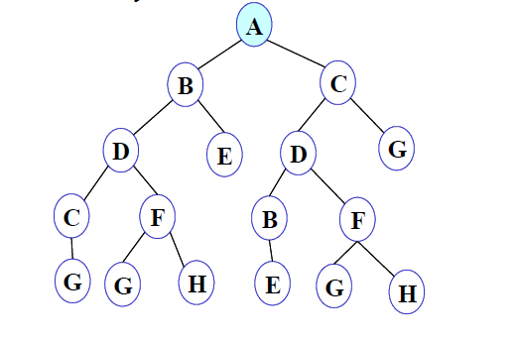
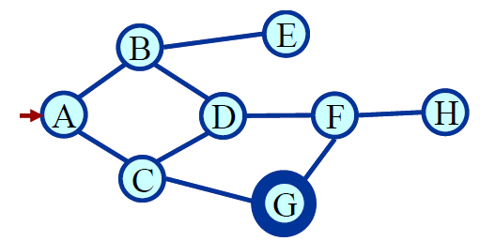
DFS Illustration
Figure 10
FRINGE: A

Slide 23
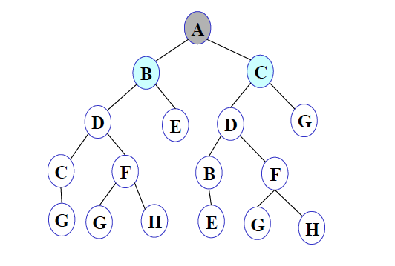
Figure 11
FRINGE: B C

Slide 24
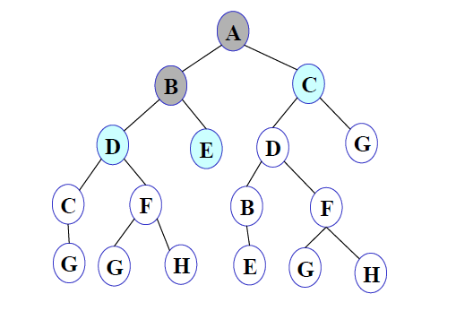
Figure 12
FRINGE: D E C

Slide 25
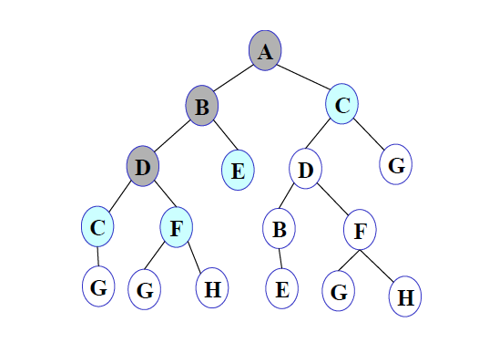
Figure 13
FRINGE: C F E C

Slide 26
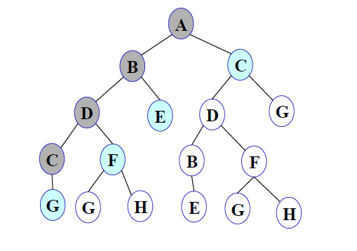
Figure 14
FRINGE: G F E C

Slide 27
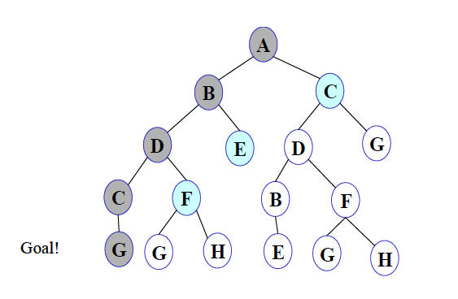
Figure 15
FRINGE: G F E C

Slide 28
DFS
LIFO order (use a stack).
Takes exponential time, O(b^{d}), but only linear space O(bN).
May not terminate without a “depth-bound” (depth limited search).
Not complete.

Slide 29
Formalizing search in a state space
A state space is a graph (V, E).
V is a set of nodes
E is a set or arcs
Each arc has a fixed, positive cost.
Each node is a data structure
A state description
The parent of the node
Depth of the node
The operator that generated this node
Cost of this path (sum of operator costs).

Slide 30
Some issue…
Search process constructs a search tree, where
Root is the initial state
Leaf nodes are nodes
Not yet expanded (i.e., in fringe)
Having no successors (i.e., dead ends)
Search tree may be infinite because of loops even if state space is small
Return a path or a node depending on problem

Slide 31
Depth Limited Search
Let fringe be a list containing the initial state
Loop
if fringe is empty return failure
Node remove-first (fringe)
if Node is a goal
then return the path from initial state to Node
else if depth of Node=limit return cutoff
else add generated nodes to the front of fringe
End loop

Slide 32
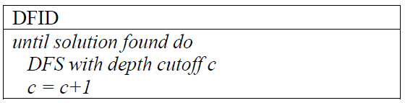
Depth-First Iterative Deepening (DFID)
First do DFS to depth 0 (i.e., treat start node as having no successors), then if no solution found, do DFS to depth 1, etc.

Slide 33
Iterative Deepening
Advantage
Linear memory requirements of DFS
Guarantee for goal node of minimal path
Procedure
Successive depth first searches are conducted – each with depth bounds increasing by 1.

Slide 34
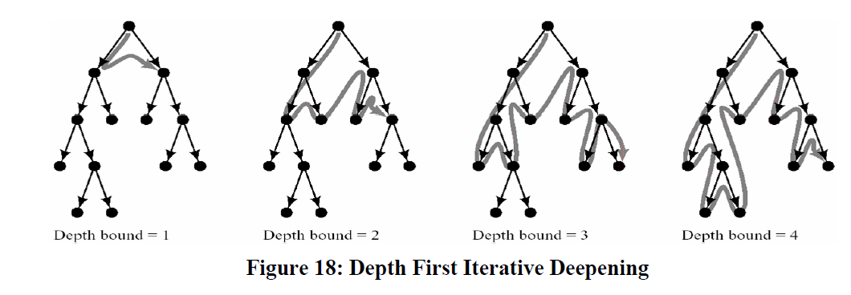
Iterative Deepening Search

Slide 35
DFID
Complete
Optimal/admissible if all operators have the same cost. Otherwise, not optimal but guarantees finding solution of shortest length.
Time complexity is a little worse than BFS or DFS because nodes near the top of the search tree are generated multiple times, but because almost all of the nodes are near the bottom of a tree, the worst case time complexity is still exponential, O(b^{d}).

Slide 36
DFID
If branching factor is b and solution is at depth d, then nodes at depth d are generated once, nodes at depth d-1 are generated twice, etc.
b^{d}+2b^{(d-1)}+…+db<=b^{d}/(1-1/b)²=O(b^{d})
Linear space complexity, O(bd), like DFS.
Has advantage of BFS –completeness and advantage of DFS – limited space and find longer path more quickly
Generally preferred for large state spaces where solution depth is unknown.

Slide 37
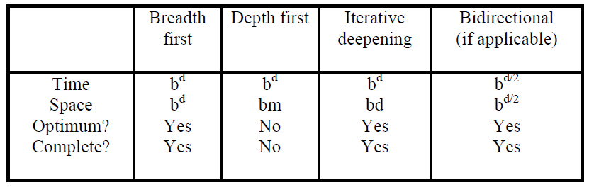
Comparing Search Strategies

